Slide 1
Introducing P’ansori and
The Story of Sim Chung
Reinventing Culture in East Asia
EASIA 237

Slide 2
Today’s lecture
Module overview: Korean P’ansori & Performance Studies (2-3)
Unit 1 resources (4)
Studying P’ansori as performance (5-8)
Simchung-ga as folk tale, written text, and performance (9-12, Images 13-15)
Wrap-up: Studying an evolving tradition (16)
Assignment & Quiz details (17)

Slide 3
Module overview:
Korean P’ansori & Studying Performance
Unit 1: The Story of Sim Chung and P’ansori Performance
  General overview, Sim Chung as example
  Entire history of P’ansori as one period (‘synchronic’ study”)
  vs. Attention to origins, change over time, etc. (‘diachronic’)
Unit 2: P’ansori Origins, Shamanic Traditions, Modernizing Popular and Elite Culture
  Questions and topics in study of P’ansori in history
  Obscure origins -> mainstream popularity -> reform, modernization, ‘heritagization’
Unit 3: P’ansori Today: Contemporary Preservation and Innovation
  P’ansori as single ‘tradition’ vs. collection of unique styles & lineages
  Heritage to be maintained and protected & living form of cultural expression?

Slide 4
Guiding questions
How to study performing arts? Vs. other narrative forms?
How to study a fluid, dynamic tradition?
What role does the audience play?
How important is it to understand ‘origins’?
“Authenticity” and “innovation” in contemporary culture?

Slide 5
Unit 1 resources
The Story of Shim Ch’ŏng / Simchung-ga
Korean romanization note: Shim Ch’ŏng / Sim Chung / Sim Cheong / 심청 / 沈淸
Book excerpt: “The Story of Shim-ch’ûng” translation
  Heavily annotated, from book-length study of p’ansori history
  Excerpt of full text from early 20th cent., with its own history
Videos: ‘Korean Traditional Music 101’ / Korean Cultural Center Los Angeles
  Ministry of Culture, Sports and Tourism / Arts Council Korea
  Video 1: Introduction to P’ansori Form
  Video 2: Simchung-ga: A pivotal scene in the performance
Complete reading & both videos before watching the rest of the lecture!

Slide 6
Studying Performance Traditions
As literature
  Focus on the ‘script’: Lyrics / plot / themes / allusions / etc.
As music
  Classification of modes, rhythms, melodies, other patterns
  How do these musical aspects create/supplement meaning?
As technique
  How are the talents necessary for performance developed, transmitted?
  What about ‘talents’ required to appreciate the performance? (“Connoisseurship”)
As social & cultural history
  Putting history of lineages & connoisseurs in broader historical context?
  Study by historians, anthropologists, ethnomusicologists, etc.

Slide 7
Intro to P’ansori (Pansori) 판소리
Performers & staging
Performers:
  Singer (‘sorikkun’ in video, also ‘kwangdae’)
    Performs all roles and narration
    Singing typically used for dialogue / monologue of characters
  Drummer (gosu / kosu)
    Rhythm to accompany vocal performance, occasional vocal interjections
Audience: Also expected to ‘participate’ with comments as appropriate
Limited set dressing, props: Fan for singer’s gestures, a painted/decorated screen
Duration: Up to 8 hours, but often performed in segments (single scene, etc.)

Slide 8
Intro to P’ansori (Pansori) 판소리
Story, transmission, performance, variation
Of 12 (?) full pieces, only 5 remain as “official” corpus of p’ansori texts.
  Adapted from folklore, Korean & Chinese history and literature, etc
But limitless potential for variation:
  ‘School’: Style of performance taught by teacher to students, etc.
    Variation in which pieces, scenes, songs performed, etc.
    Teaching is intensive and rigorous, involves years of dedicated study & practice
  Individual performer
    Even within a school, performers cultivate unique styles, excel in different areas, etc.
    Teachers may transmit different elements to different students, or teach in different ways.
  Each performance is unique
    Atmosphere of theater, mood and health of performer, audience, etc...
‘New’ p’ansori also written, even today (more in Unit 3).

Slide 9
Studying P’ansori
As literature
  Much to study: Allusions, humor, structure, characterization & dialect (& more...), but...
  Stories from folklore, in a tradition w/ many variations in script based on performer, lineage
As music
  Notation of complex rhythms, melodies, etc.; similarly variable among performers & lineages
  How to label, classify features? Standard musicology terms, specialized vocab of p’ansori...?
As technique
  Discerning in technical features requires ‘training’ as p’ansori performer, or connoisseur
  Not to mention complex vocal techniques. Can non-performers understand?
As social & cultural history
  ‘Inside’ vs. ‘outside’ history: Studying p’ansori as a performer in a lineage, vs. broader view
  Many scholars of pansori performance and history are also trained as performers

Slide 10
Summary of folk tale of Sim Chung
A blind man and his wife raise a beautiful, talented daughter, Sim Chung
  Sim Chung’s mother dies soon after, and her father struggles to raise her
Sim Chung offers to sacrifice herself so that her father can regain his sight
  A large offering of rice to a temple should restore his sight. Sim Chung allows herself to be sacrificed to calm the sea, for which her father will be paid the required amount of rice.
Though father’s sight is not restored, a deity of the sea pities her, and she returns to life.
  Sim Chung visits the undersea palace, and is reborn in a lotus flower
The reborn Sim Chung meets the king, who marries her.
When father & daughter finally reunite, his vision is restored
Note ‘scenes’ or other segments with potential for excerption, embellishment, etc.

Slide 11
The Song of Shim Ch’ŏng: The Text
Textual history
“P’ansori novels”
  Written, published versions of P’ansori ‘scripts,’ first published late 19th/early 20th cent.
  Text & performance: Not basis for performance, but adapted from other performances.
  Written version meant to be read, but simulates elements of performance
Textual history: Manuscript, printing, etc.
  100+ written versions of p’ansori version(s) of this story
  60 manuscripts, a dozen early printed versions (bw 1870-1920)
  Later versions derived from one or more of these, or transcribe later performances
Our text:
  “Wanp’an edition” printed 1916 in Jeonju (Chŏnju), key city for p’ansori performance
  Based on performance tradition of River & Mountain School (more in next unit)

Slide 12
The Song of Shim-ch’ŏng: The Text
Narrative, embellishment, allusion, annotation
Translation : ~110 pages. Our excerpts: First & last scenes
The plot can be recounted in a few minutes.
What features make this version longer? What kinds of details are added?
  Dialogue, monologue, narration
    Display talents of performer, embodying multiple characters & narrator
  Patterned lists of activities, objects, etc.
    Opportunity for vocal flourish, rhythmic patterns, etc.
  Allusions: References to classical Chinese, Korean history, lit., philosophy
    Presumed prior knowledge of audience?
Annotations:
  Footnotes added by translator, explain allusions & other details
  Margin notes taken from original text,
  indicate narration (aniri) vs modes/rhythmic patterns in songs (chung mori, etc.)

Slide 13
Simchung-ga: The performance
Likely to be many differences between this performance & our ‘script’
  Consider also role of translation
How does singer distinguish between dialogue as characters / narration?
What role does drummer play? When does he speak?
In addition to words, what elements of performance contribute to emotion & story?
  Gesture, sitting/standing, singing/speaking, movement, etc.
Consider: Aspects of performance may come from “school,” teacher, personal style...
What about staging? Artwork, lighting, colors, costume... a ‘traditional’ performance?

Slide 14
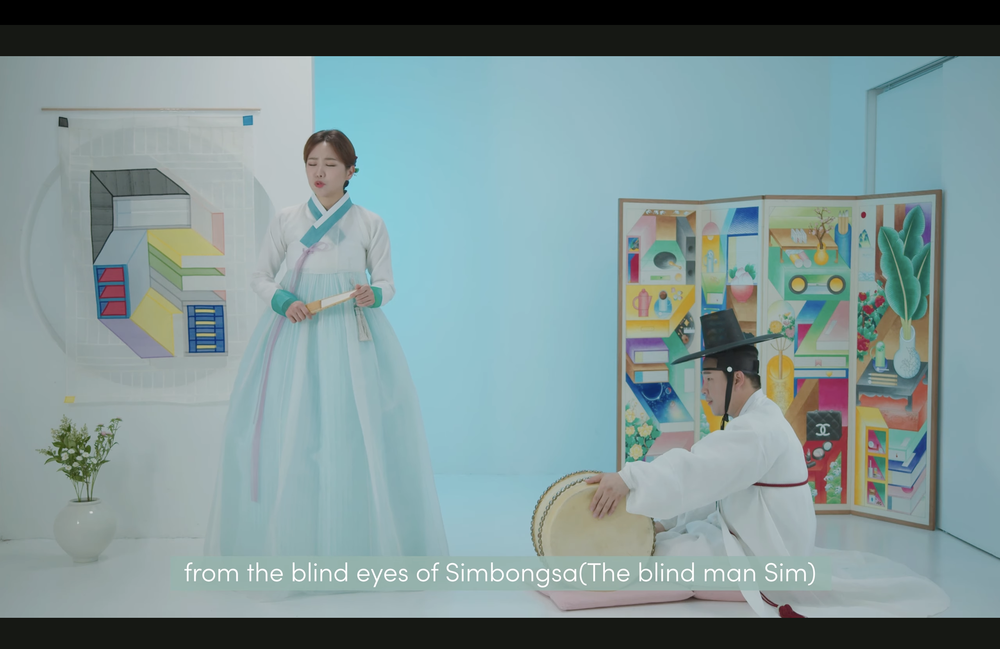

Slide 15
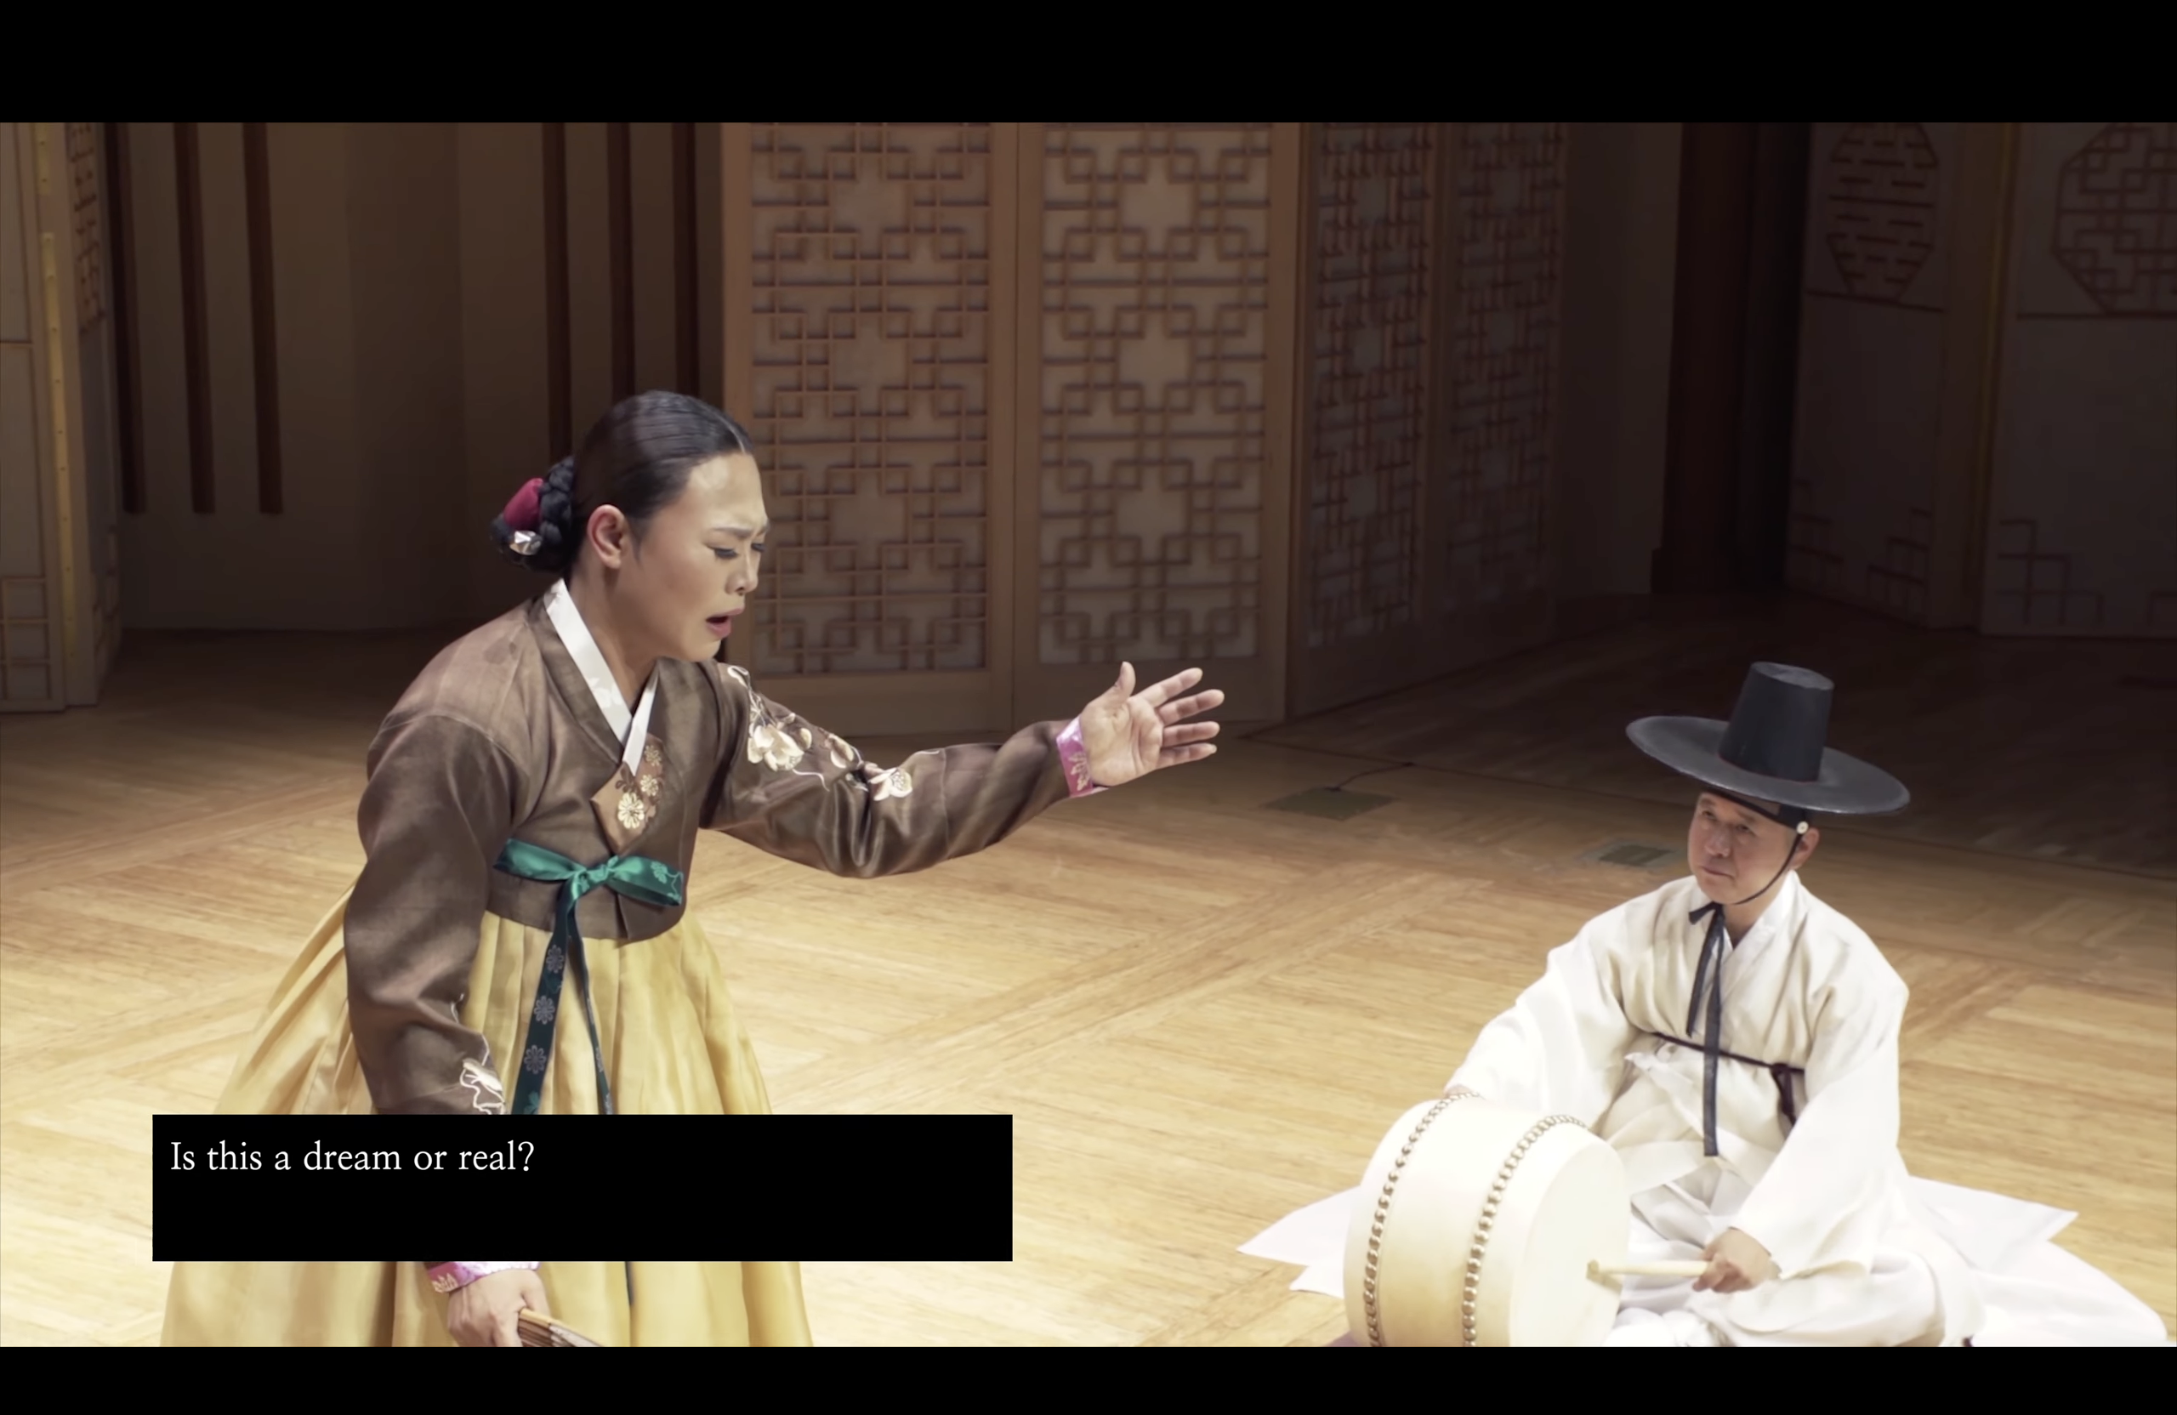

Slide 16
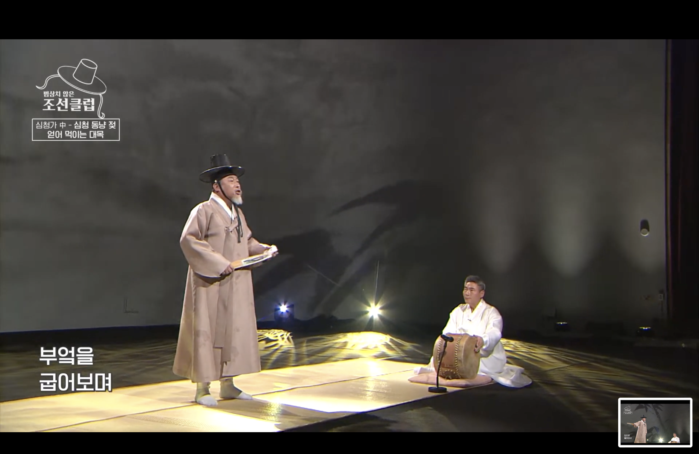

Slide 17
Wrap-up: Studying an evolving tradition
Basic details of pansori performance are consistent:
  2 performers, singer & drummer
  Limited props, backdrops, etc.
  Full performances can be quite long, but often performed in scenes or other excerpts
Beyond this, many variables:
  School, teacher, individual style...
  Context & purpose of performance
What about bigger changes over longer periods of time?
  Next unit: History of Pansori from ‘origins’ to roughly 20th century
  Final unit: Pansori in contemporary times (which today’s videos are part of!)

Slide 18
Assignment and Quiz details
Assignment: This unit focuses on a single example, adaptations and interpretations of the folk tale of Sim Chung. It has been ‘adapted’ countless times, from traditional theatrical performances to picture books, films, and more. The lecture notes several ways the performance of this story vary even within the context of p’ansori performance. What about other media?
Think of another example of a folk tale or popular story, and write a brief description of 2-3 adaptations of it in different media (film, television, book, etc.). How do the technical constraints, audience expectations, formal conventions, etc. of this medium impact the presentation? What about other artistic and creative choices? Write a short description, with reference/comparison to details from lecture if possible.
Quiz: Basic details of p’ansori performance (all technical/foreign terms will be defined), plot details from assigned excerpts of text, issues in study of performance & theatre. 5 questions, 10 minutes to complete.

Slide 19
Additional reading & videos
Performances:
  National Gugak Center Folk Music Group performance of Simchung-ga, by Yeom Kyeong-ae drummer Jeong Jun-ho. Filmed at Pungnyusarangbang Theater, National Gugak Center, Seoul. https://youtu.be/7UgNOvHx4_c?si=C9L3gUQy0KtqBcrS
  KBS televised performance of Simchung-ga by Wang Ki-seok https://youtu.be/LrMb2ixf9Eo?si=7RQigHaATUP6FAZ9 (unfortunately no Eng subs)
Reading:
Jang, Yeonok Korean P’ansori Singing Tradition: Development, authenticity, and performance history. Scarecrow Press, 2014.
Park, Chan E. Voices from the Straw Mat: Toward an Ethnography of Korean Story Singing. Honolulu: University of Hawai‘i Press, 2003
Um, Haekyung. Korean Musica Drama: P’ansori and the Making of Tradition in Modernity. Ashgate, 2013.

